Slide 1
Predicting Yields of Selected Crops in Manitoba
Mustapha Oyegunle
Mentor : Ruhid Mirzayev

Slide 2
Overview
Introduction
Problem Statement
Project Definition – Predicting Yields for Selected Crops in Manitoba
Data Collection and Preprocessing
Methodology
Linear Regression

Slide 3
Introduction
The population of Humans and animals is rapidly growing and needs timely supplies of food at affordable prices. Hence, there is a strong need for farmers to be able to predict yields of crops (within small error) in the planning stage, assuming other controlling factors, like climatic conditions, access to capital, and technologies are favorable.
The need for experience and use of historical data to derive data-driven decision-making has always been underestimated by some farmers.

Slide 4
Problem Statement
It is common for existing farmers to rotate to new crops and new farmers not to leverage the existing historical data to estimate the expected yields of the new crop in the province. This has been part of the causes of the great losses incurred by some farmers, especially the small and medium-scale ones.
Resolving the challenges to predict crop yields will help to greatly reduce unforeseen losses and help Ag insurance companies to accurately set insurance costs (premiums) tailored to each crop.

Slide 5
Project Definition
This project aims to generate predictive functions to accurately predict average crop yields and deviations (Std Devs) when the crop type and future year are supplied.
These predictions use the linear regression method, which in turn is assumed to average out the effect of soil quality (type), climate, and improving Ag technologies.
The follow-up project is planned to incorporate the Manitoba GIS map and predict within each Rural Municipality and soil types using trained models in machine learning.

Slide 6
Data Collection and Preprocessing
Data cleaning is a very crucial step in Data Science and Analysis. The models and algorithms for predictions vary widely on how data cleaning is performed
Data cleaning includes identifying and fixing of:
Missing values like NaN or null
Incorrect values or outliers
Incorrectly formatted
Corrupted values
Incomplete data
Standardizing the units of measurement

Slide 7
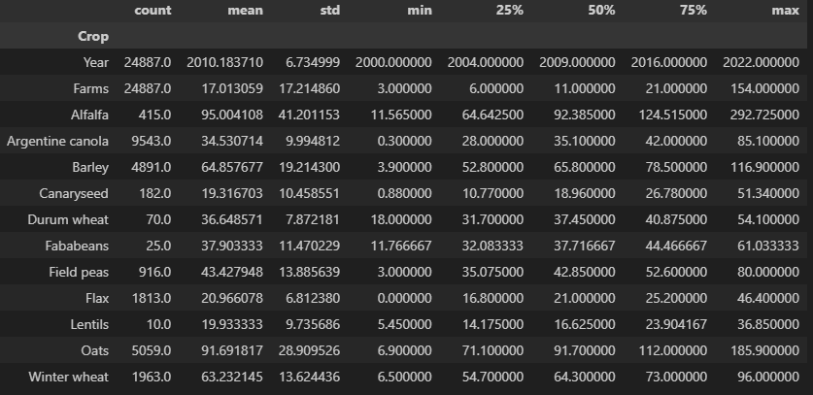
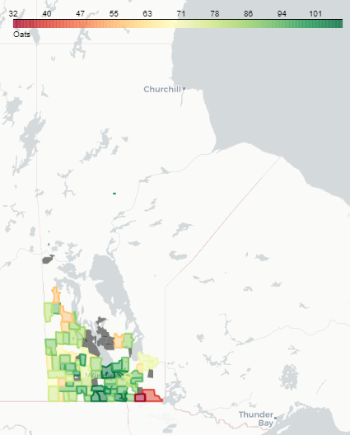
Resource Data

Slide 8
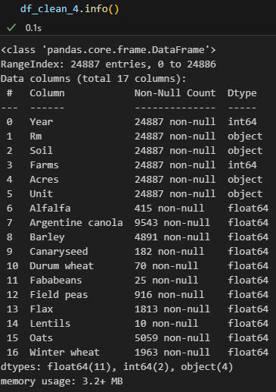
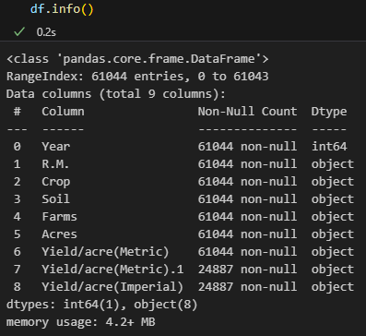
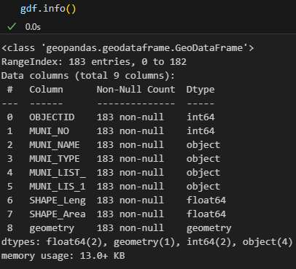
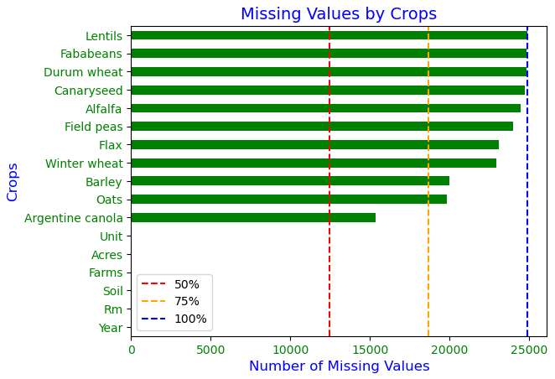
Data Collection and Preprocessing
Ensure no duplication of data
Format the columns to the required data-type
Review Missing Values and treat appropriately

Slide 9
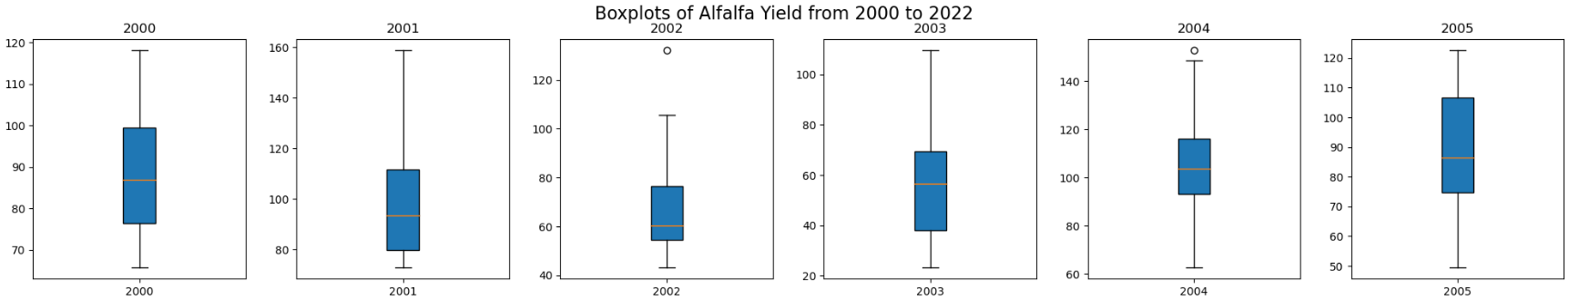
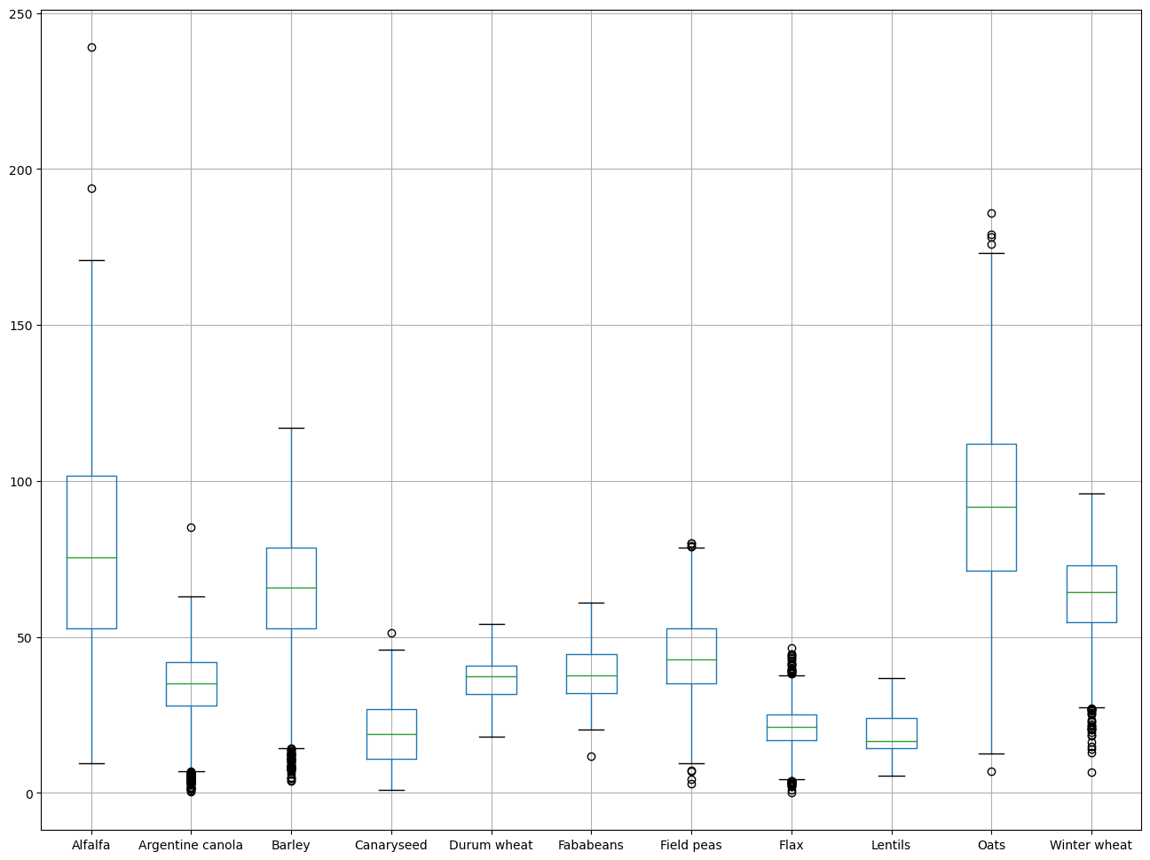
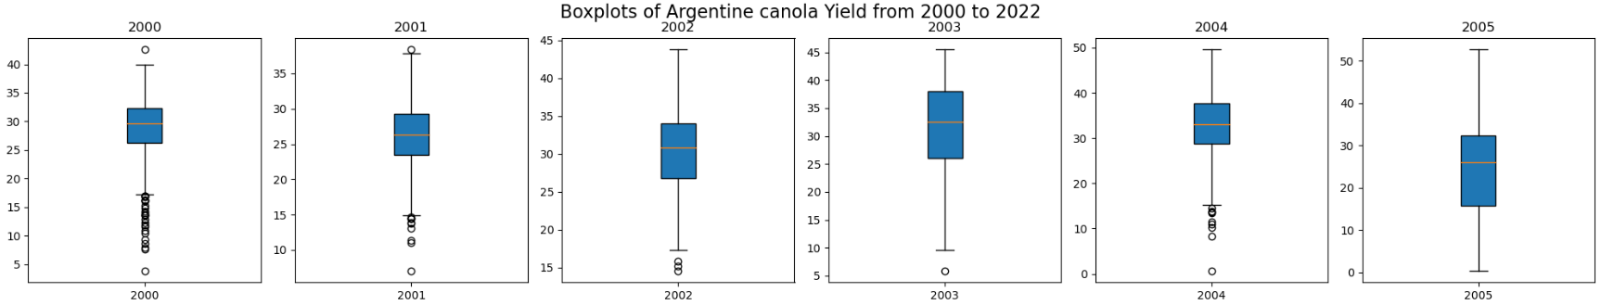
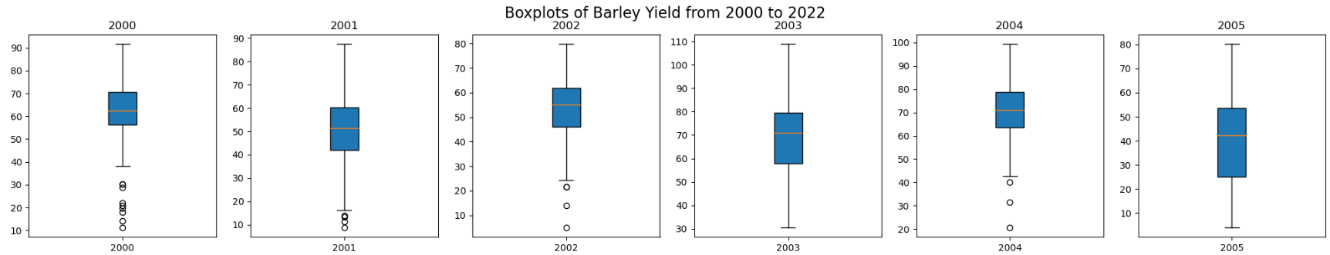
Data Collection and Preprocessing
Identifying Outliers per crop per year and treating them appropriately

Slide 10
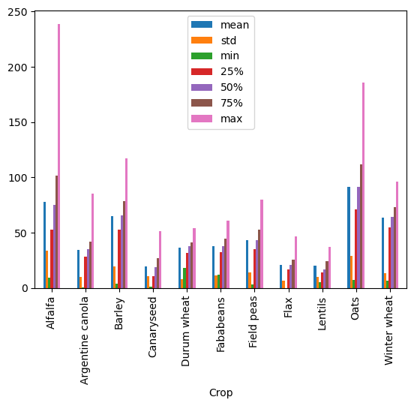
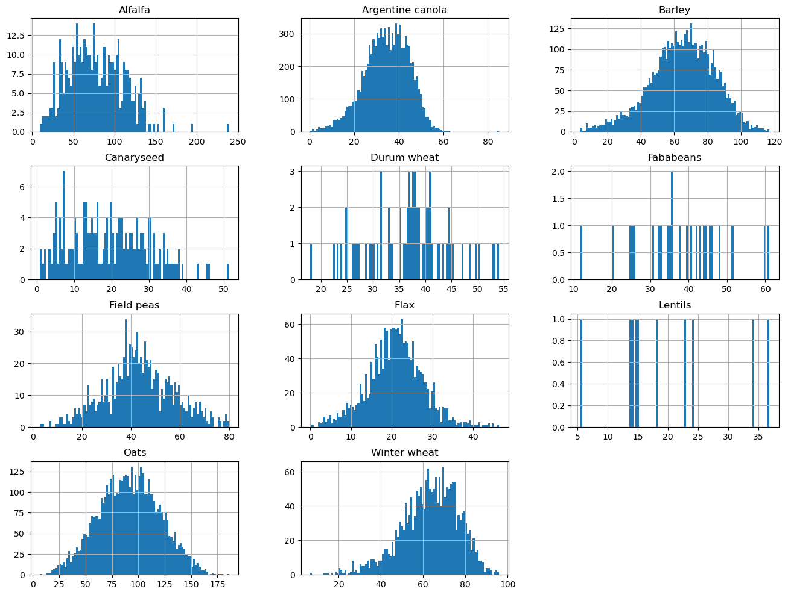
Data Collection and Preprocessing
Checking the distribution and the skewness of data

Slide 11
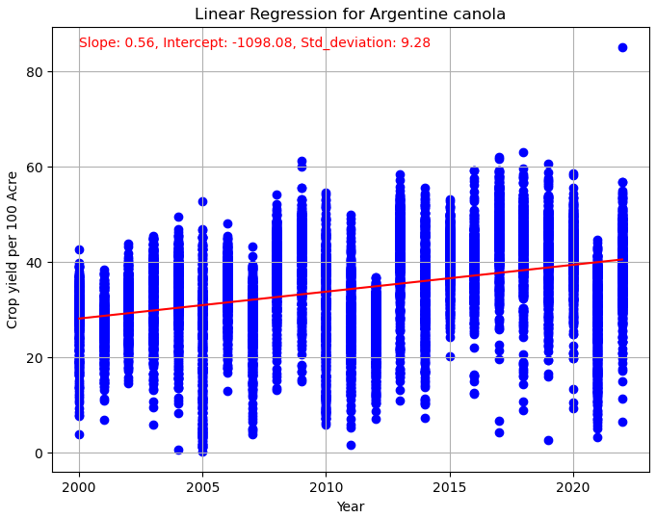
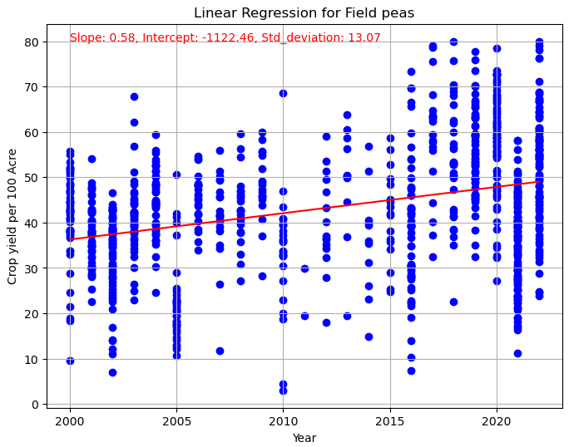
Methodology

Slide 12
Estimating Yields for Selected Crops
Alfalfa: Regr Equatn: Yield/100 Acres = (-0.98 * Year) + 2076.20 | Std Dev = 40.48 Bushels
Arg. Canola: Regr Equatn: Yield/100 Acres = (0.56 * Year ) + -1098.08 | Std Dev: 9.28 Bushels
Barley, Regr Equatn: Yield/100 Acres = (0.90 * Year ) + -1747.60 | Std Dev: 18.25 Bushels
Canaryseed, Regr Equatn: Yield/100 Acres = (0.74 * Year ) + -1460.39 | Std Dev: 9.81 Bushels
Drm Wheat, Regr Equatn: Yield/100 Acres = (-0.42 * Year ) + 879.33 | Std Dev: 7.77 Bushels
Fababeans, Regr Equatn: Yield/100 Acres = (0.80 * Year ) + -1558.46 | Std Dev: 10.38 Bushels
Field peas, Regr Equatn: Yield/100 Acres = (0.58 * Year ) + -1122.46 | Std Dev: 13.07 Bushels
Flax, Regr Equatn: Yield/100 Acres = (0.33 * Year ) + -640.08 | Std Dev: 6.57 Bushels
Lentils, Regr Equatn: Yield/100 Acres = (7.74 * Year ) + -15463.32 | Std Dev: 6.23 Bushels
Oats, Regr Equatn: Yield/100 Acres = (1.47 * Year ) + -2861.80 | Std Dev: 27.07 Bushels
Winter wheat, Regr Equatn: Yield/100 Acres = (0.28 * Year ) + -505.31 | Std Dev: 13.56Bushels

Slide 13
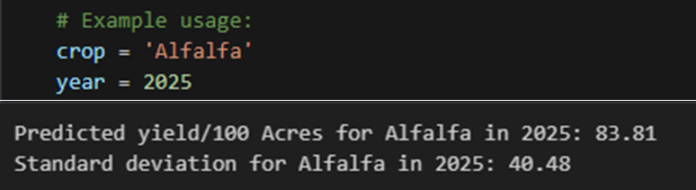
Prediction Result

Slide 14
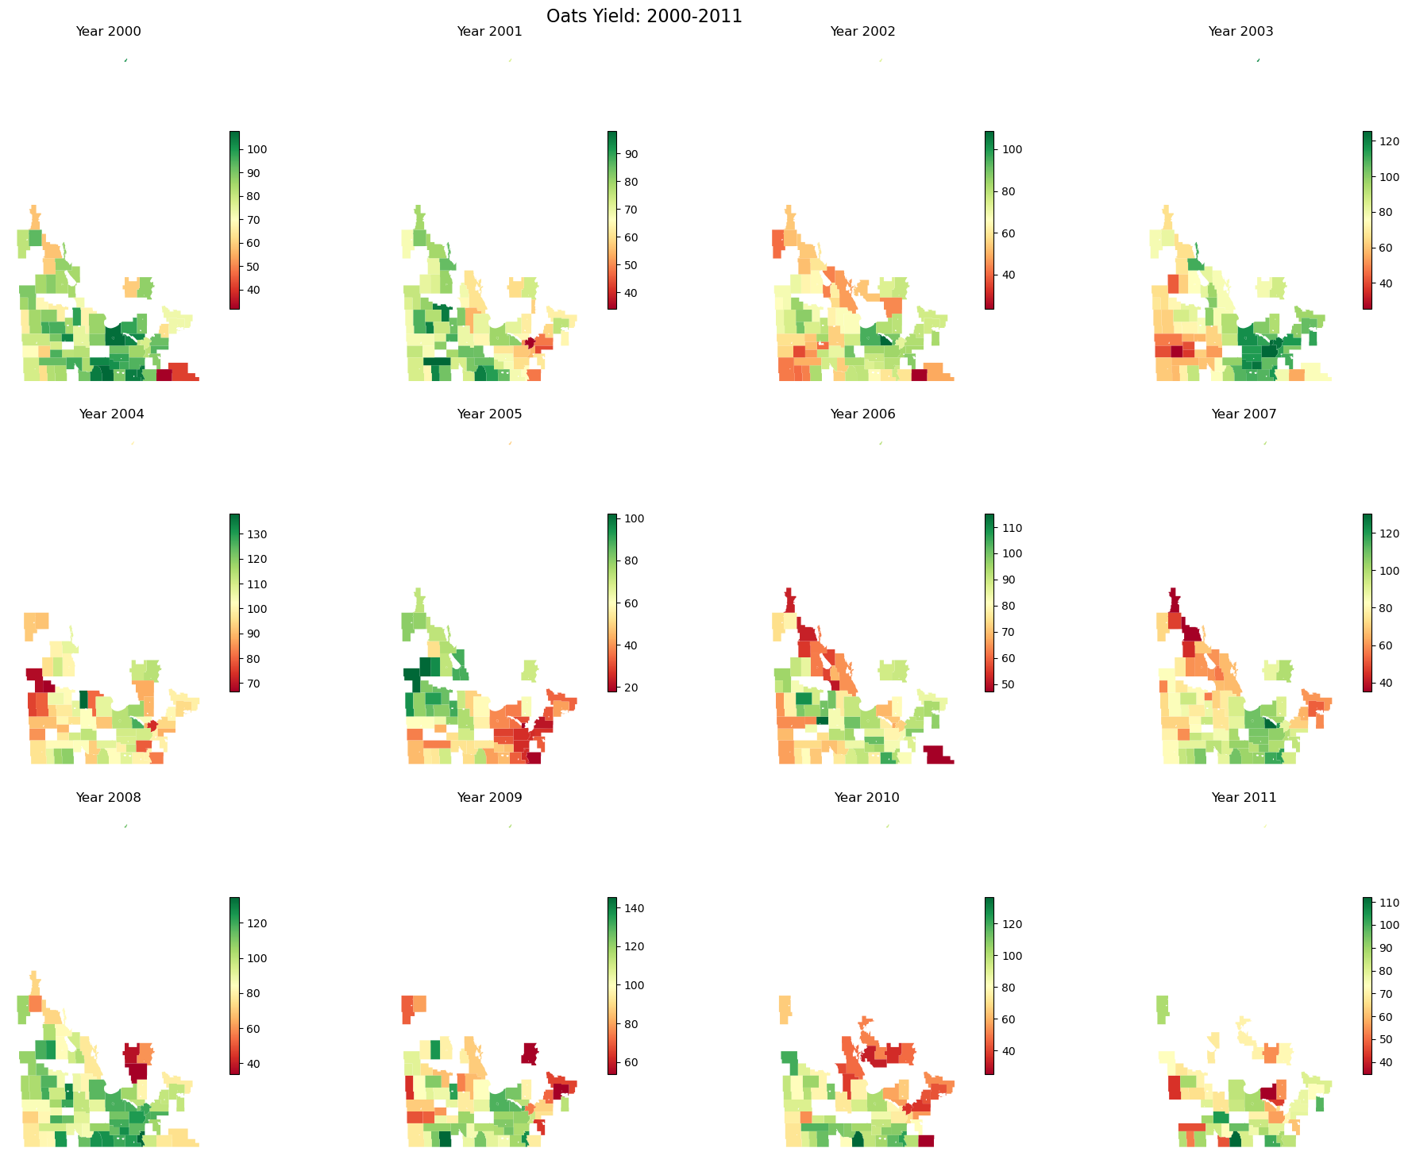
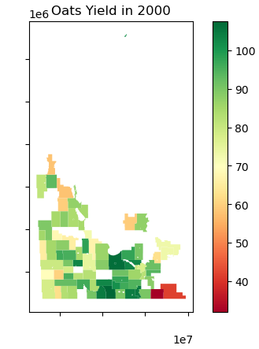
Project Phase 2: Manitoba

Slide 15
Thank you

